Slide 1
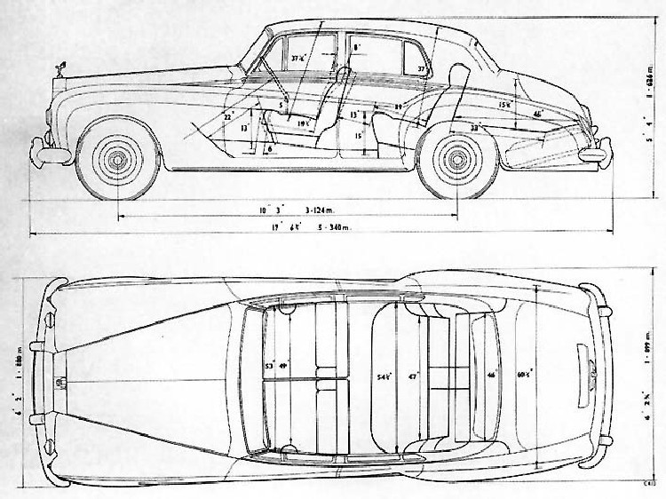


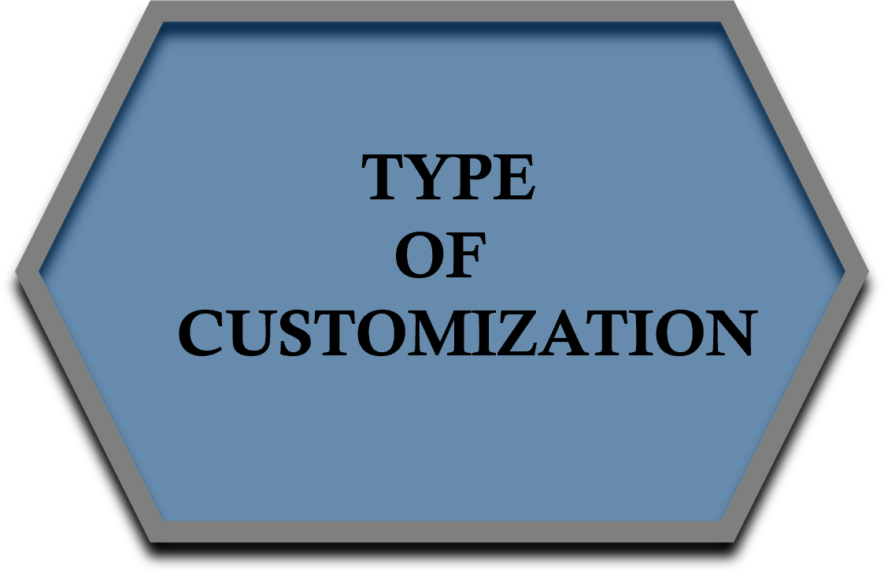


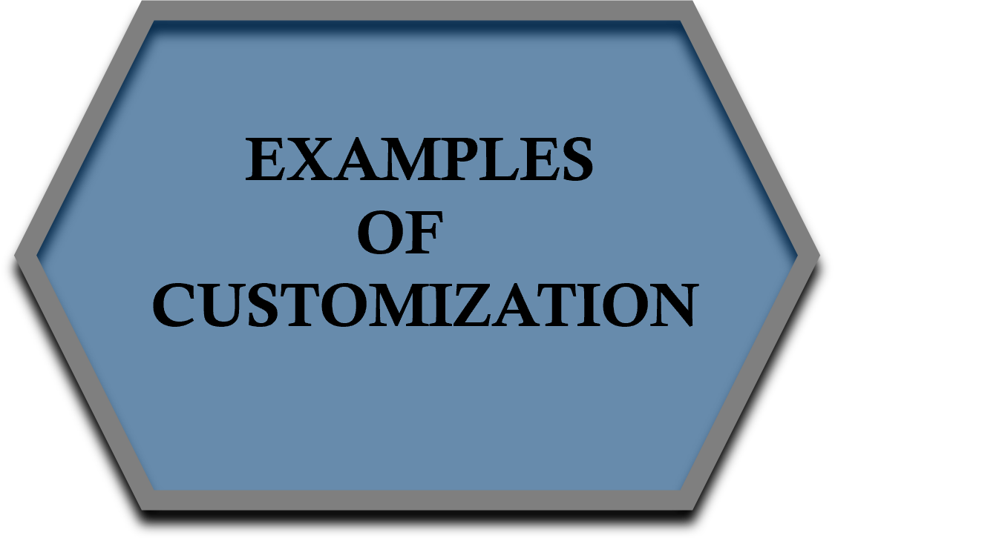
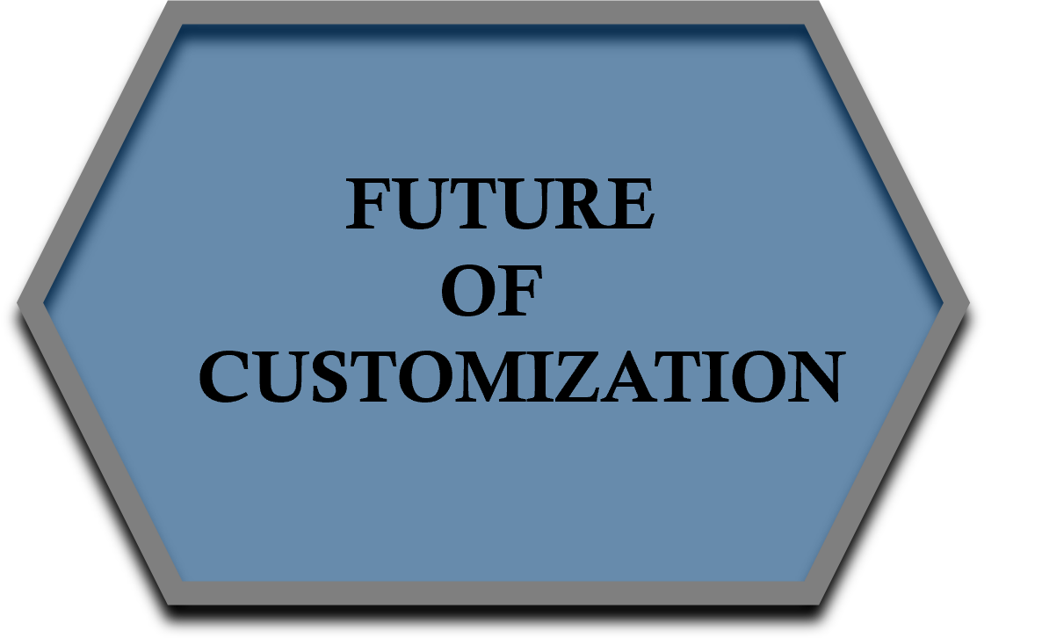
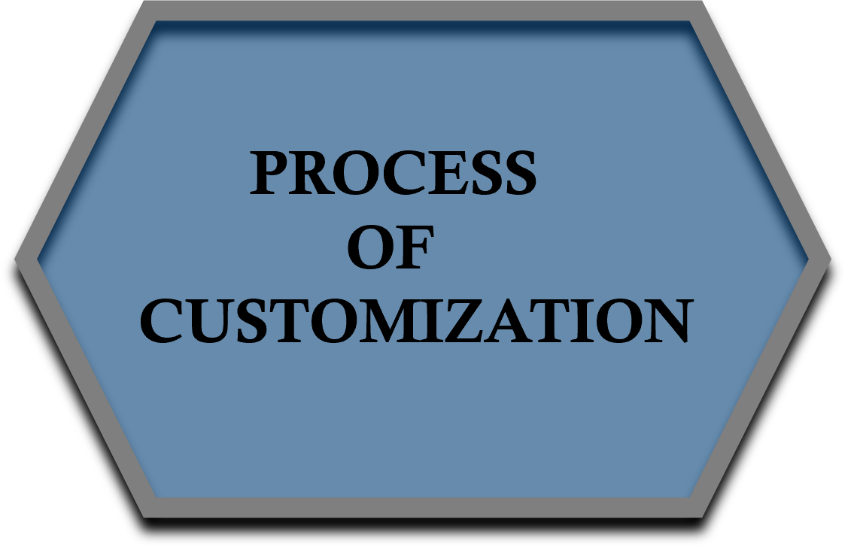
Presented By:-
Name: Yadav Rohit Krishna Kumar
Branch: CE
Batch: 4B
Roll No: 213
Enrollment No: 22002170110210
ROLLS-ROYCE CUSTOMIZATION

Slide 2
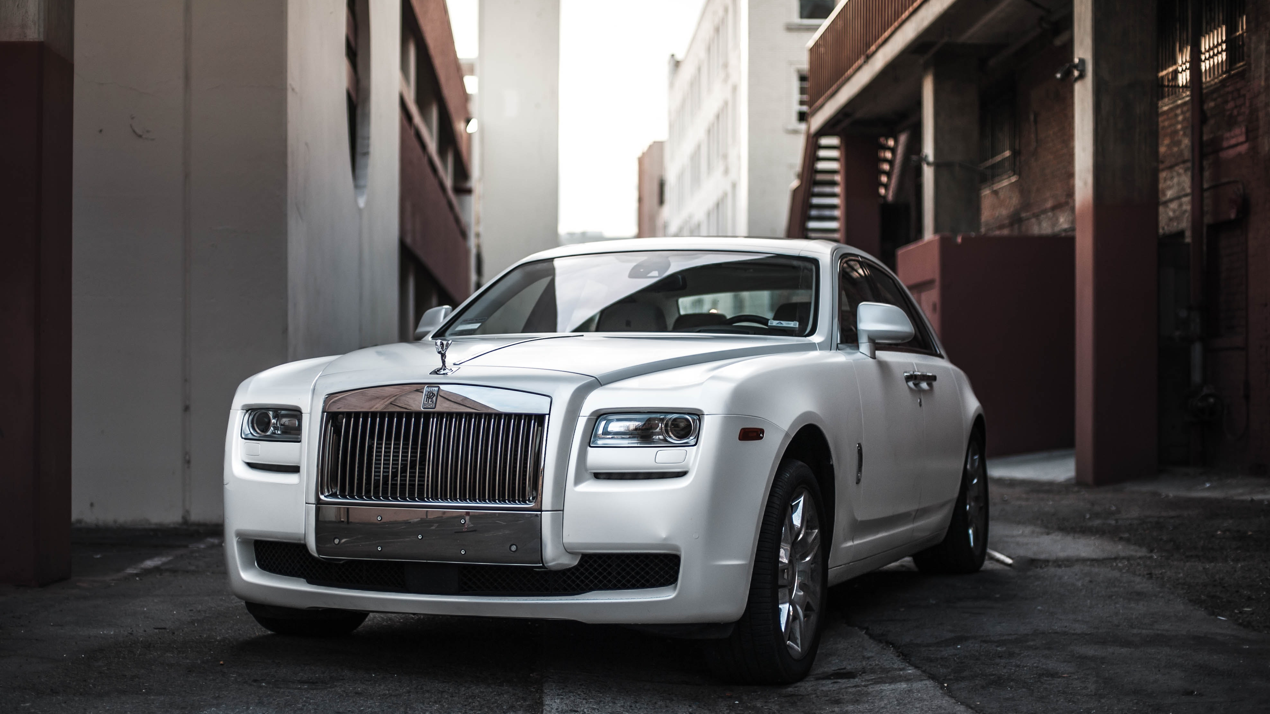
INTRODUCTION
One of the key features that sets Rolls-Royce apart from other luxury car brands is its customization options.
Rolls-Royce offers an extensive range of custom-made services, allowing customers to create a car that is uniquely tailored to their individual tastes and preferences.
This level of customization allows customers to create a car that is a true reflection of their personality and style, making it a highly sought-after status symbol.

Slide 3

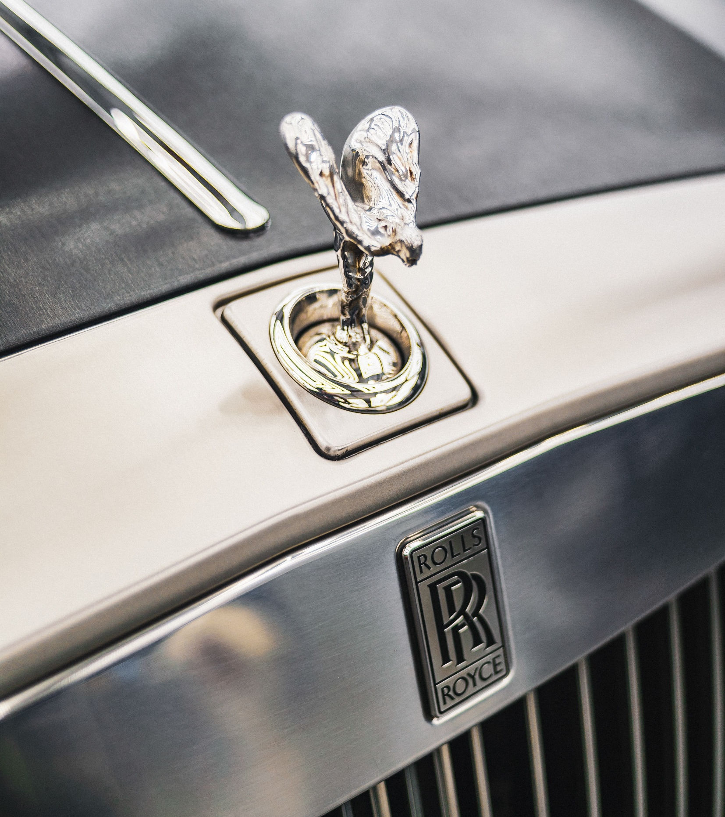
TYPE OF CUSTOMIZATION
Exterior Customization
Interior Customization
Audio and Entertainment Customization
Custom-Designed Accessories
Performance Customization

Slide 4
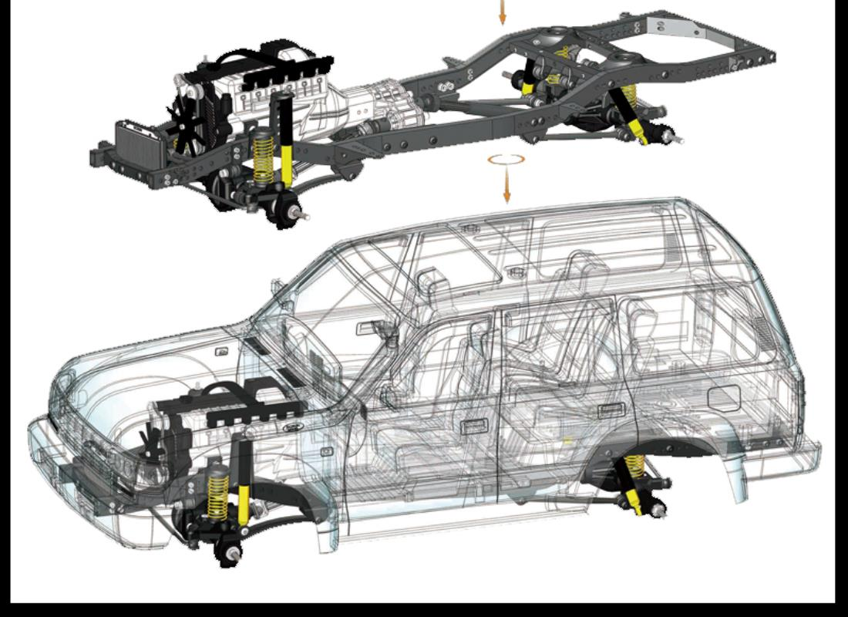
PROCESS OF CUSTOMIZATION
Consultation
Design Proposal
Design Review
Crafting
Quality Control
Delivery

Slide 5
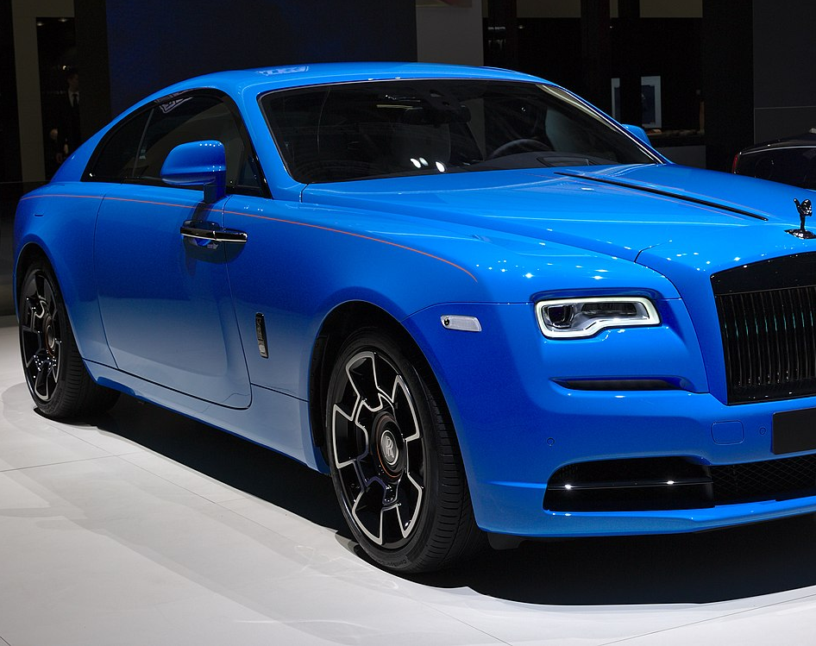
EXAMPLES OF CUSTOMIZATION
MODEL: GHOST
EXTERIOR COLOR: BLUE
INTERIOR: LATHER
ADDITIONAL OPTIONS: NIGHT VISION

Slide 6
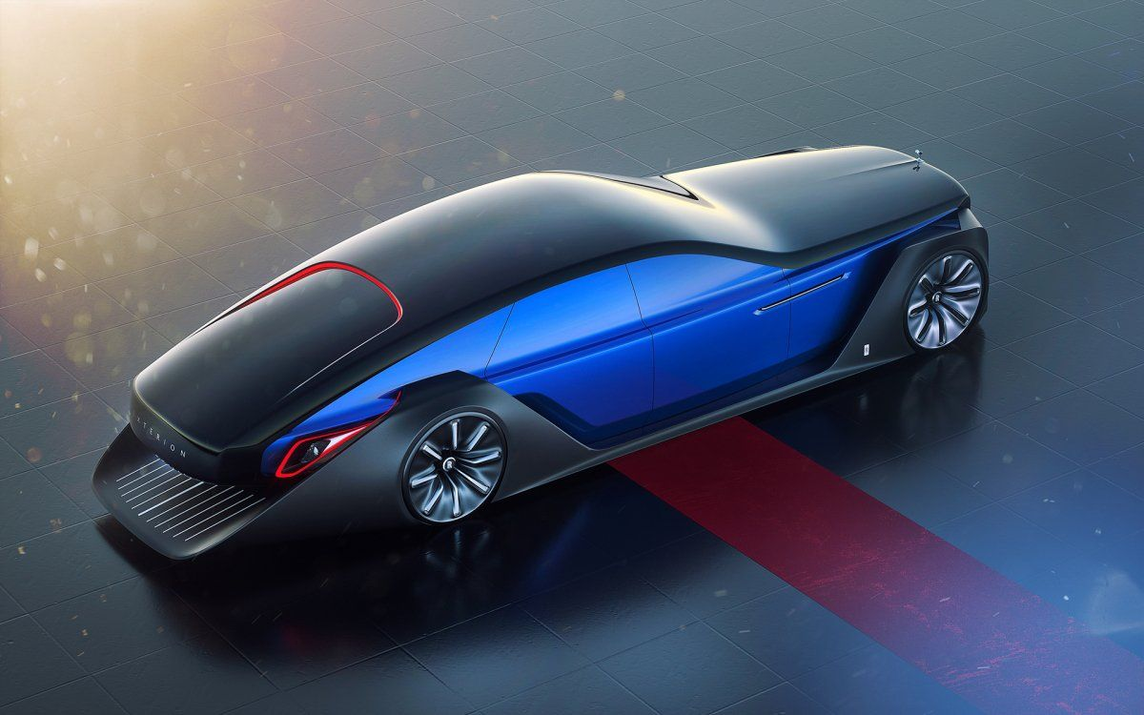
FUTURE OF CUSTOMIZATION
Rolls-Royce is exploring the use of digital design tools and technologies to enhance the customization process
Rolls-Royce is exploring the use of sustainable materials in its customization options, such as vegan leather and recycled materials.
Rolls-Royce is researching the use of artificial intelligence to personalize the driving experience
Future customization options will continue to evolve and adapt to changing customer preferences and technological advancements

Slide 7
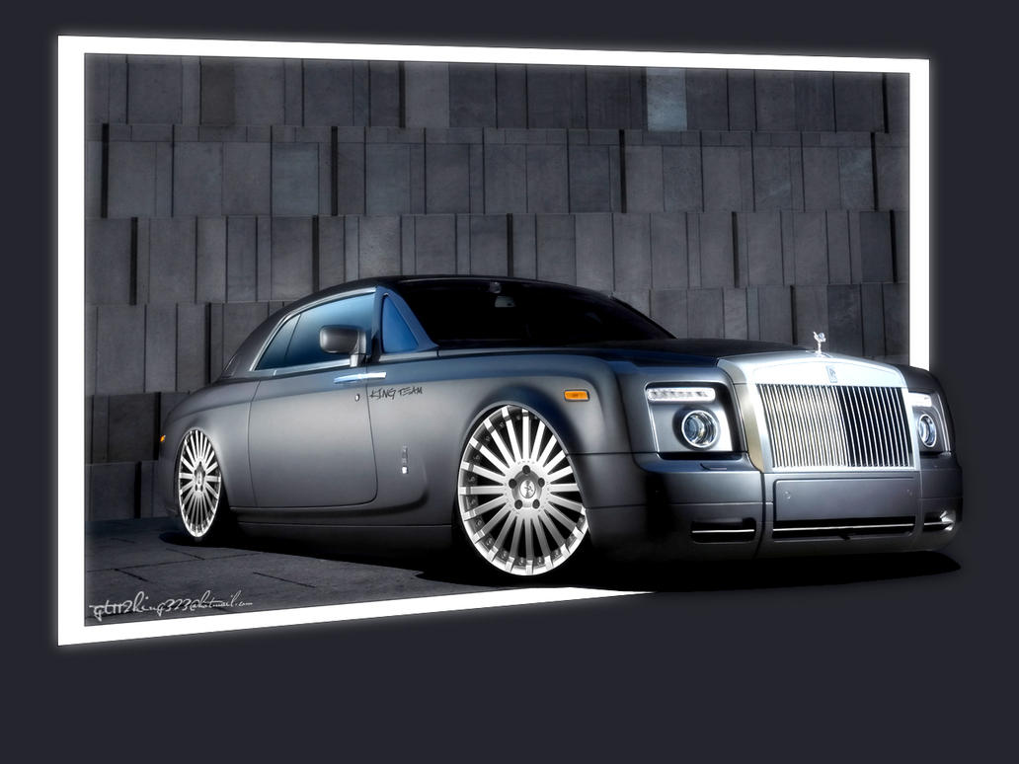
CONCLUSTION
Rolls-Royce customization is not just about aesthetics; it also includes performance enhancements and advanced technology features.
The customization process may take several months, but the result is a vehicle that is truly one-of-a-kind and a reflection of the customer's personality and lifestyle.

Slide 8


